Slide 1
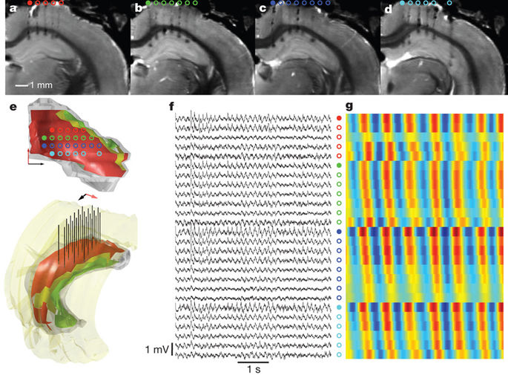
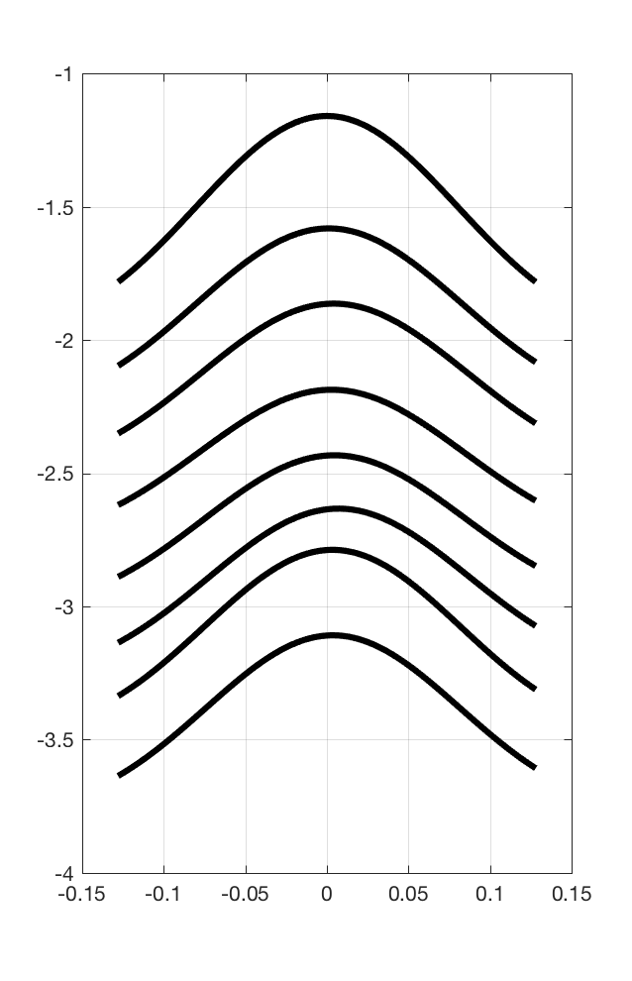
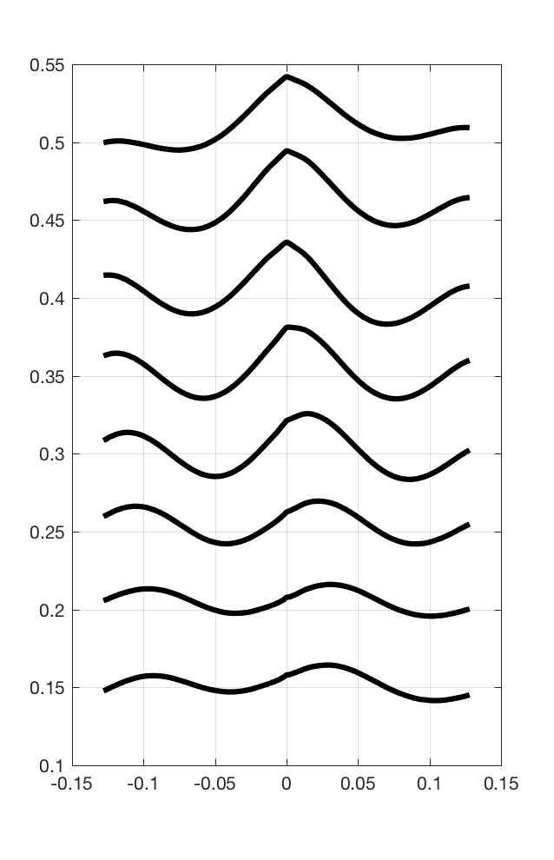
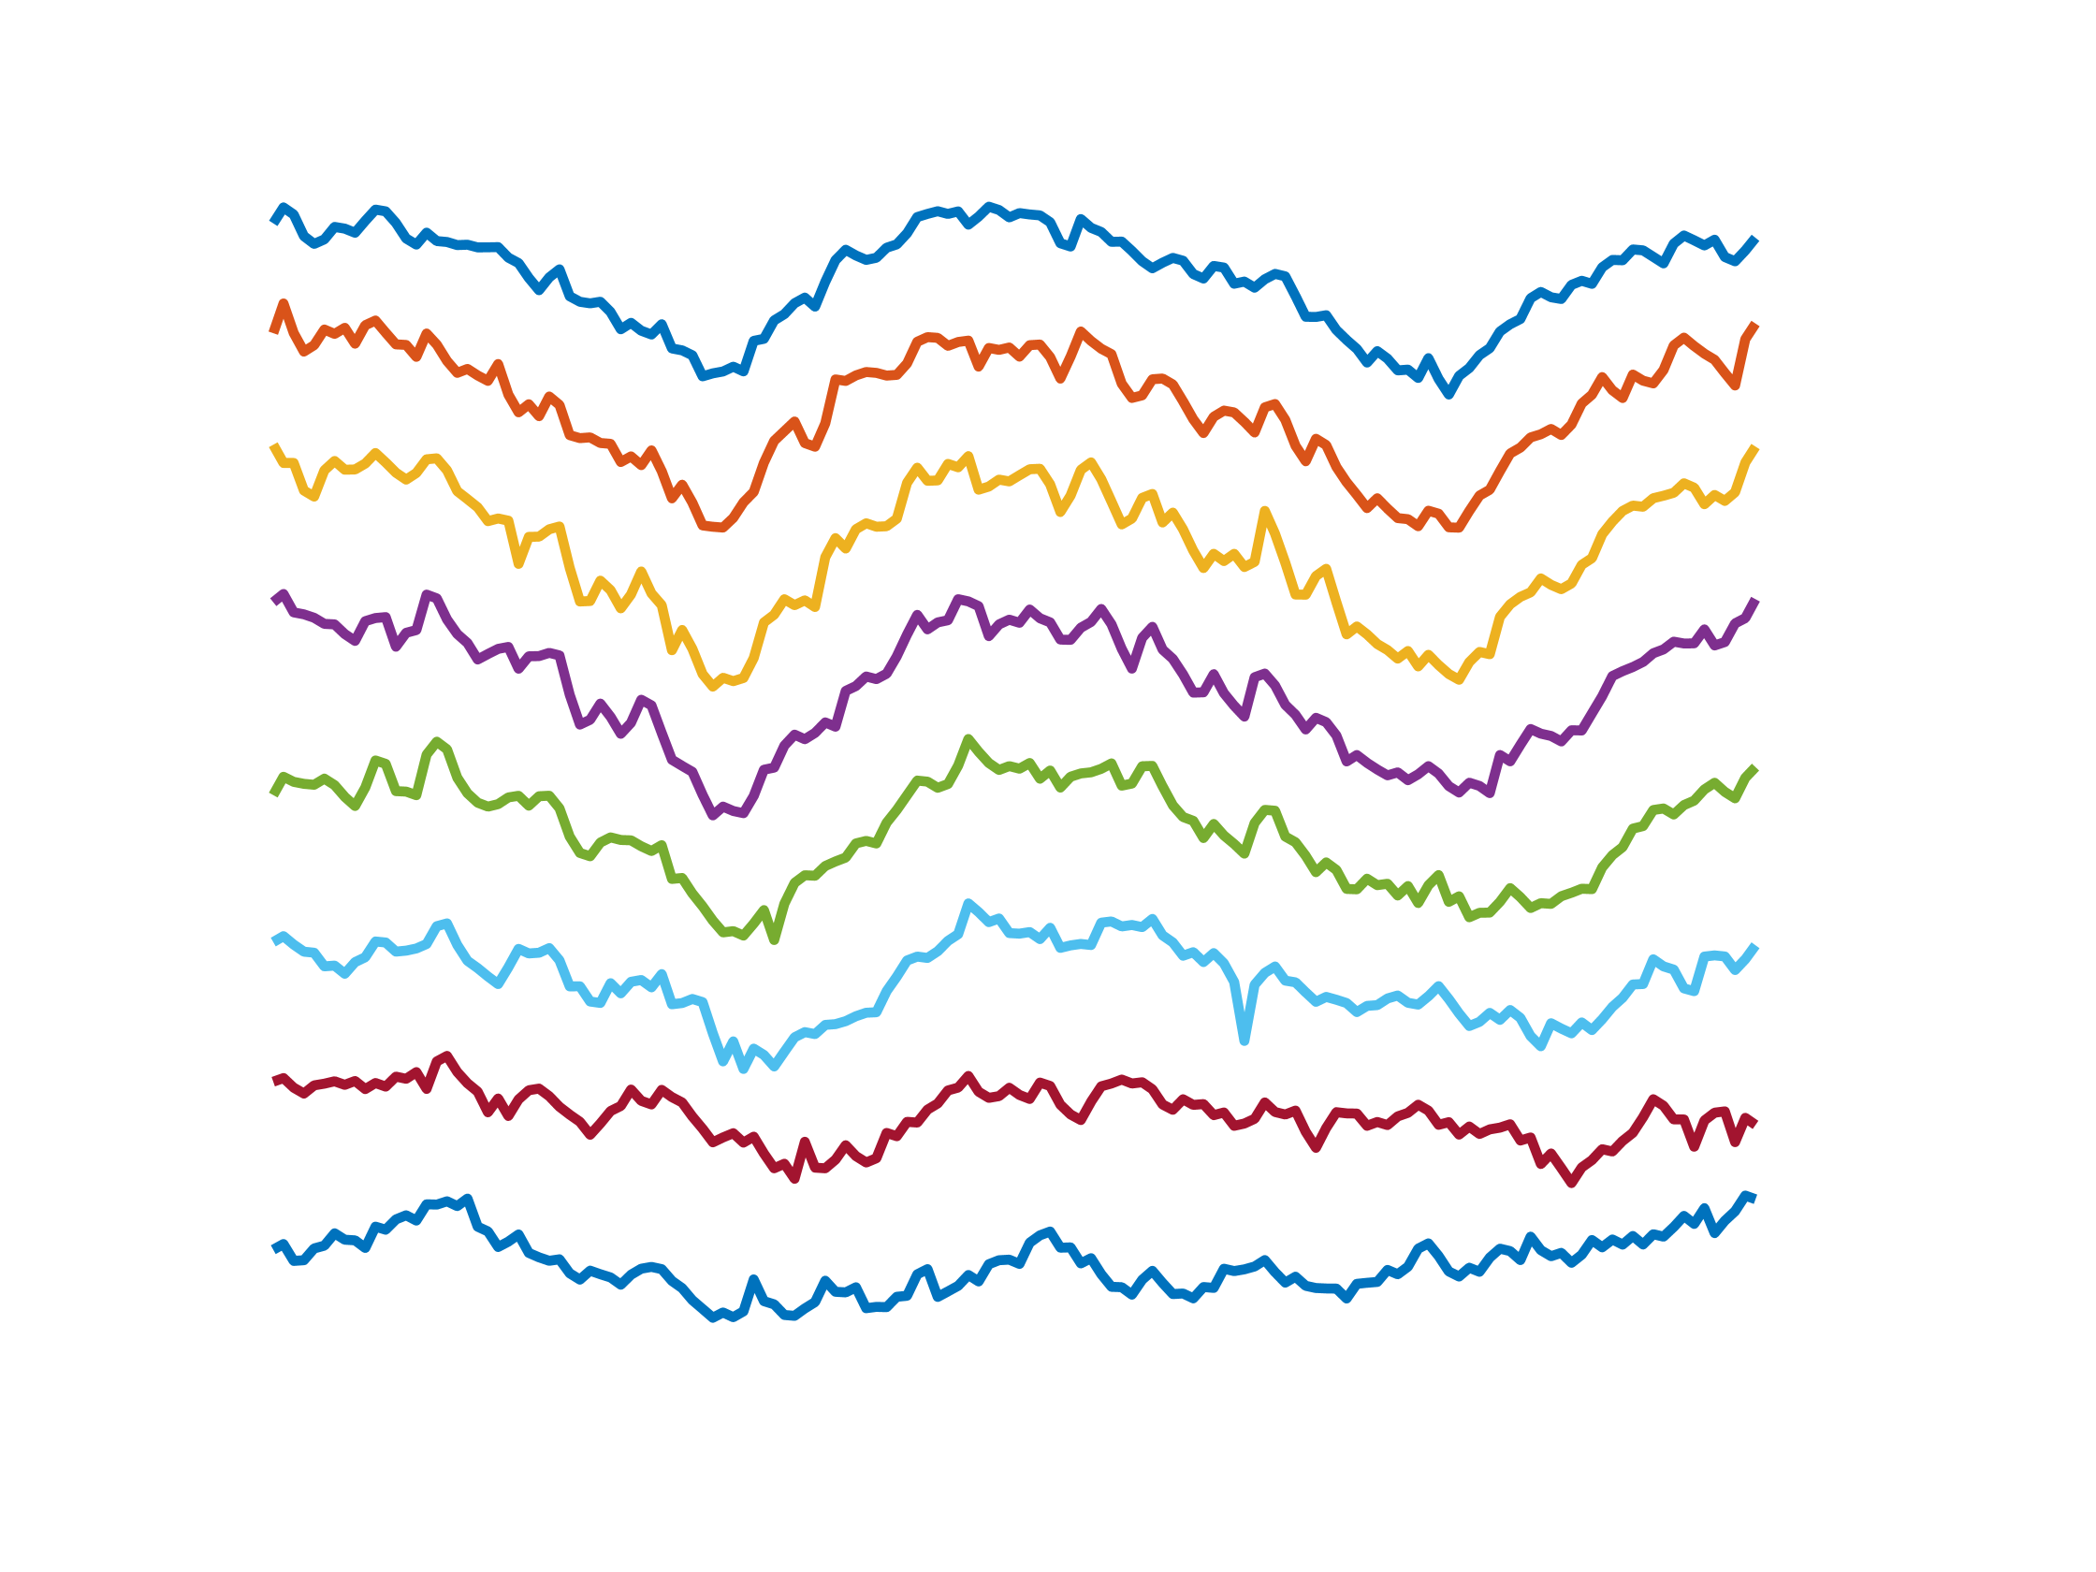

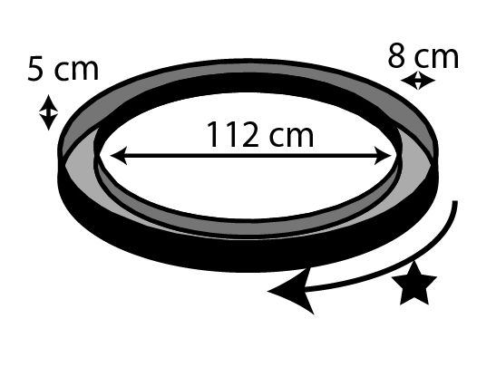
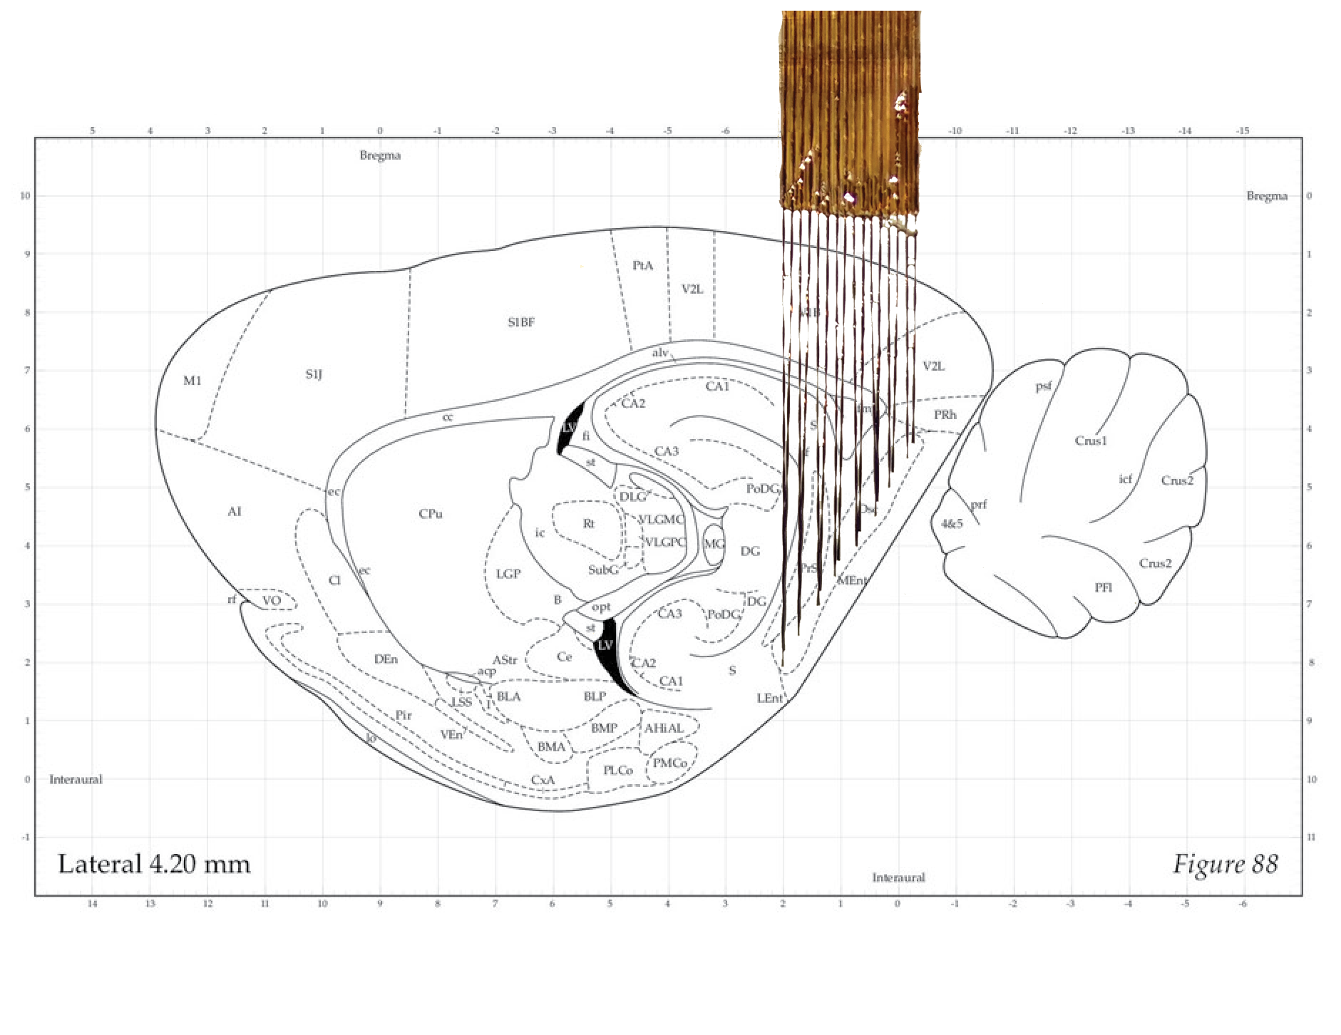
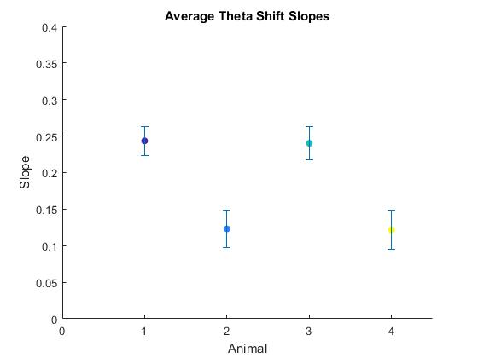
Is Theta a Traveling Wave
in the Medial Entorhinal Cortex?
Keiland Cooper, Jesus Hernandez, Ehren Newman
Department of Psychological and Brain Sciences, Indiana University, Bloomington, IN
Abstract
The hippocampus and medial entorhinal cortex support spatial learning, yet the relationship between their dynamics and information processing during learning remains unknown. Both exhibit clear theta rhythms, 6-10 Hz fluctuations in the local field potentials, that are thought to track information processing by these areas. Remarkably, in the hippocampus, theta is not synchronous throughout, but rather, precesses steadily across the long axis to span a total of 180 degrees phase offset (Lubenov and Siapas, 2009; Patel, 2002). It remains unknown whether theta phase also shifts along the long axis of the medial entorhinal cortex. To resolve this, we built custom electrode arrays designed to simultaneously record across the entire long axis of the region (spanning >4.5 mm) at regular intervals (~580 um). Using these arrays to record theta in awake behaving rats, we find consistent evidence of a systematic theta phase shift along the length of medial entorhinal cortex. To address whether this reflects a traveling wave or phase-shifted standing wave, we asked if there are comparable lags in theta power changes across the long axis. We found zero-lag in theta power indicating that, in the entorhinal cortex, theta is a phase-shifted standing wave. We also find that the properties of theta along the long axis of the entorhinal cortex are consistent with those previously reported for the hippocampus in that there is a 180 degree total shift and that theta coherence decreases between distal sites. We discuss the functional implications of these results for the hippocampal information processing.
Motivation
METHODS: Data Analysis
RESULTS CONTINUED
3. Analysis of temporal coding of space over cell pairs
Population activity improves predictability of cell spiking similarly during scopolamine and baseline, indicating intact assemblies.
Decoding position from 40ms epochs gives same peak probability of position under scopolamine, indicating that population code at fine temporal scale (40ms) remains intact.
4. Zero lag in theta power hints at standing wave
Left LFP xCorr showing a progressive shift in theta
Right Theta power xCorr, displaying a 0 lag in power
RESULTS
1. YES! Theta is a traveling wave in the MEC
CONCLUSIONS
Like in the hippocampus, theta is a traveling wave across the dorsal/ventral axis of the medial entorhinal cortex
Assemblies remain intact after systemic blockade of muscarinic cholinergic receptors.
Reduced phase precession is not due to noisy spike timing at the individual cell level.
METHODS: Data Collection
What is causing the loss of phase precession?
Scopolamine injection
Dosage: 0.5 mg/Kg
Control: Equal volume saline
Recording procedutes
dHPC coord: 5.5AP,2.5ML
16 tetrodes, bundle of 1.8 mm width
Averaged theta cycles across recording session
FUTURE DIRECTIONS
2. Theta shift is consistent across animals
CCG alignment preserved as well after scopolamine injection as in saline control
Overall correlation between cell pairs is modestly, but significantly, increased
REFERENCES
Newman EL, Venditto SJC, Climer JR, Petter EA, Gillet SN, Levy S (2017). Precise spike timing dynamics of hippocampal place cell activity sensitive to cholinergic disruption. Hippocampus.
Harris KD, Csicsvari J, Hirase H, Dragoi G, Buzsaki G (2003) Organization of cell assemblies in the hippocampus. Nature.
Dragoi G, Buzsaki G (2006). Temporal Encoding of Place Sequences by Hippocampal Cell Assemblies. Neuron.
Zhang K, Ginzburg I, McNaughton BL, Sejnowski TJ (1998). Journal of Neurophysiology.

